Slide 1
ECONOMICS
A CASE STUDY OF CERAMIC TILES

Slide 2
Introduction
We tried to notice the variation in the Demand and Supply of the Ceramic Tiles over the time. We also compared the complementary products and also the Substitute Products. We focused on various factors like Raw Material , Competition etc.
Case Study of Ceramic Tiles , Changes in demand , supply over the time with comparing different manufacturers

Slide 3
Theories that helped us
Demand Theory
Elasticity of Supply

Slide 4
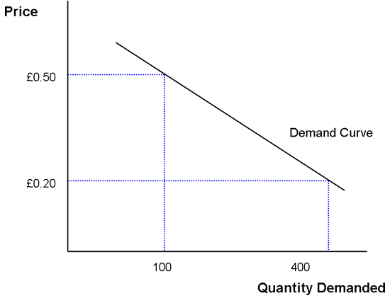
What Actually Theories Are
DEMAND THEORY – Considering the price of the product as the only factor ,the demand for the product is inversely proportional to its price.
i.e., when price goes up demand goes down

Slide 5
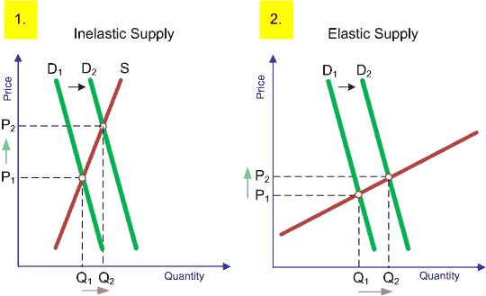
PRICE ELASTICITY OF SUPPLY – In simple words , It is the change in supply of product corresponding to the change in the price of that particular product On condition that other factors that affect the supply of product are kept constant

Slide 6
An overview of ceramic business:
The ceramic business of tiles is very old which started from early man made tiles to today’s highly technically prepared tiles.
The project emphasis on the ceramic market of Morbi.
At present there are around 650 ceramic units in Morbi which include spray driers, wall tiles units, vitrified units (which in turn is divided into three parts soluble salts, double charged, GVT and PGVT), sanitary wares unit.
And these industries together covers almost 60% of middle east area, many parts of Europe, many parts of Asia and around 80-85% of Indian market(till recent time after which China started import at a very low price).

Slide 7
Factors that affected the price and demand of the Ceramic Tiles
Availability of Raw Materials
Transportation
Labor
Government Policy
Imports from other countries (especially from China)
Competition
Technological Innovation

Slide 8
Why demand of Ceramic tiles went up
Due to increase in the income of common man , their unlimited wants resulted in the wish to have their own home.
Also the ceramic zone with time became a monopolistic business. The competition increased day-by-day. So the cost also became affordable.

Slide 9
Raw materials:
The raw material for ceramic tiles is fine grained body clay which is produced in spray-drier. The price of raw material directly affect the end user price.
Price variation graph of body clay:
There is an inelastic demand in the raw material over the time(for Red Body).

Slide 10
Substitutes and Complementary Products:
The Substitutes along with price is as follows:
Wooden flooring :- 150 -1200 Rs per square feet
Marble flooring :- 250 – 2000 Rs per square feet
Kota stone :- 22 – 25 Rs per square feet
Ceramic Tiles :- 32-130 Rs per sq. feet

Slide 11
Complementary products

Slide 12
Factors affecting the price:
The demand has been increased over time and the reason of this demand is trend as well as affordability. This demand creates a vast range of price.
The government policies which includes the taxes, c-form, GPCB (Gujarat pollution control board) norms and other regular norms.
The use of fuel i.e. gasifier vs. gas.(A burning issue for ceramic hub)
One of the major factor which is mostly awaited by the ceramic hub is anti damping duty which will allow the domestic market to compete with import market especially China.
Labor cost:

Slide 13
Factors affecting Margin or Profit:
As shown earlier the ceramic market belongs to monopolistic market category. So a tough competition is there.
And also the competition is unhealthy due to increase in upcoming weak firms day-by-day.
The technology used has an important role in deciding the margin(like as digital, double charged, etc.)
The monopoly in ratios and types of raw material has also a key role in quality determination which in turn affects the margin.

Slide 14
Factors affecting demand:
As mentioned above the demand is created by on going trend. As the trend changes people want to stay with stay with the flow and accommodate with the change.
Demand of such products also depends on the position of real estate market. As because when the real estate business is on fire ceramic business is also on peak fire.

Slide 15
Comparison of Johnson and Kajaria

Slide 16
Comparison of Johnson and Kajaria
The Margin value for Johnson and Kajaria is very difficult task to attain because both are MNCs which work on 50-50 or 51-49 job work basis and all the job work firms have different margins based on the factors like location, raw material availability, etc.

Slide 17
Conclusion
Following are main points of conclusion:
Ceramic business is a monopolistic market zone(and with a very tough and unhealthy competition).
The price variation is basically controlled directly by demand by producers rather than the consumers demand based on price. i.e. the producers want to sell their products at any cost to stay in this tough competition. We can say that it is a consumer controlled industry.
A very rapid fall and rise in price is seen which is may be due an unhealthy competition
The future market is still strong as because the present period is judgment period in which many weak firms would have to leave the market and a very high and growing demand of tiles is seen. One reason is also because of affordability of tiles even in rural areas tiles are making their way.

Slide 18
Thanks to:
Avani Minerals, Dharti Minerals and Sun Minerals(Spray drier raw material data)
Spectrum Johnson Ceramic(wall tiles data)
Cosa ceramic(Kajaria MNC data)

